Slide 1
G2P Android Tablet Usability Test Findings
Amber Brown and UX Research
August 11th, 2011

Slide 2
Overview
Evaluated GoToMyPC on Android tablets.
8 people participated in person at the San Francisco Usability Lab.
Participants’ profile:
4 current GoToMyPC customers
4 prospective GoToMyPC customers
7 current Android Tablet users, 1 current Android phone user
All users had a need to access a computer from their Android device

Slide 3
Methodology – RITE Method
Changes based on issues discovered during testing were made in-between testing days based on the following criteria:
Stakeholders and researcher agree on the issue.
The issue is clear and obvious.
There is an obvious solution.
The solution aligns with the original goals of the test.
It is a reasonably likely problem for future participants.
It has had a strong effect on the task we were asking the user to complete.
Once team has prioritized issues, Manoj confirmed that the Dev Team could fix them in the allotted time.

Slide 4
Task 1: “How would you access your work computer from your Android tablet?”

Slide 5
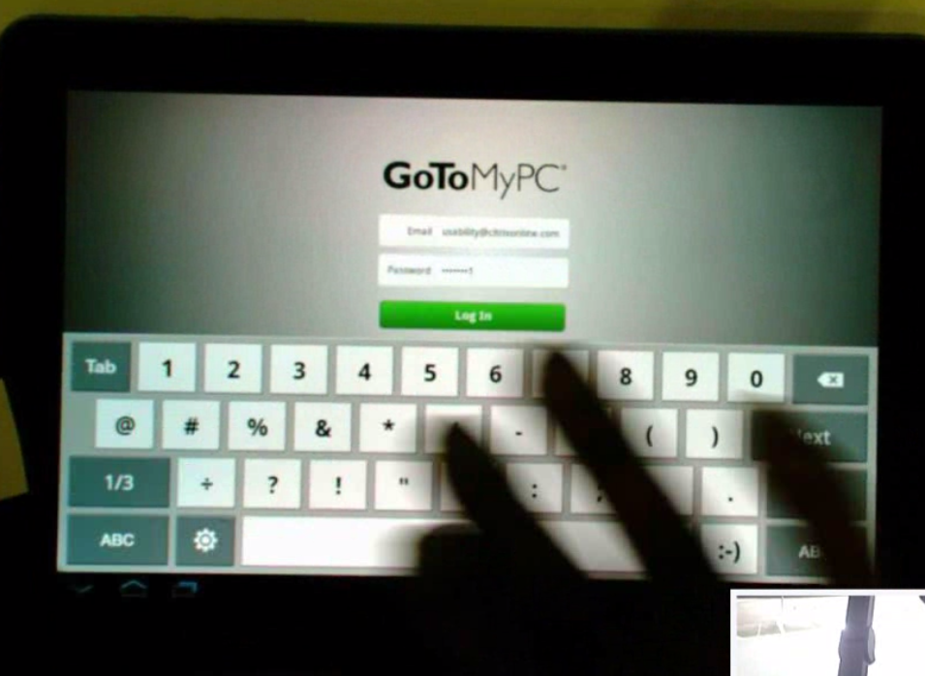
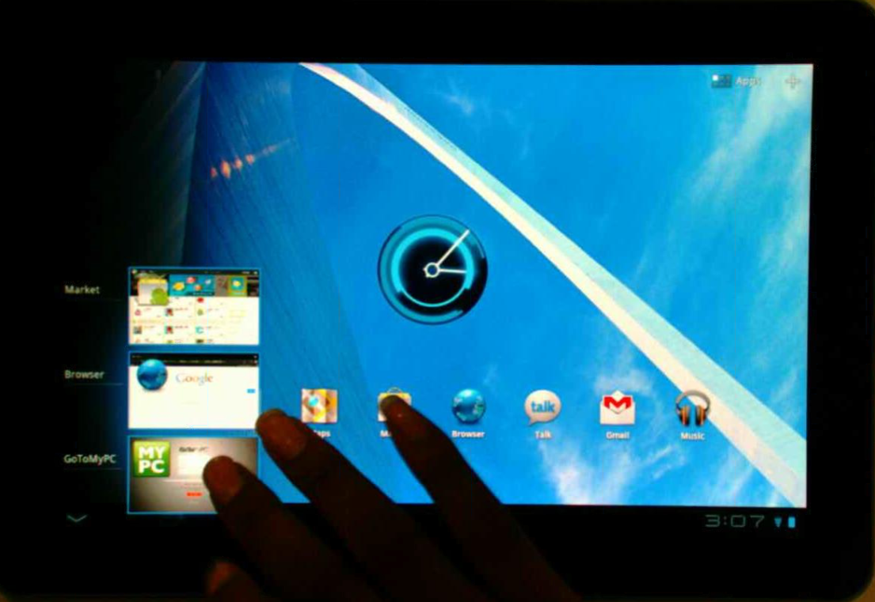
Connecting to the Host
Most users did not have any issues with logging in to the app, connecting to the host from the My Computers screen, and entering in their access code.
Some users accessed GoToMyPC through the Apps page.
Some users accessed GoToMyPC using the multi-tasking icon.

Slide 6
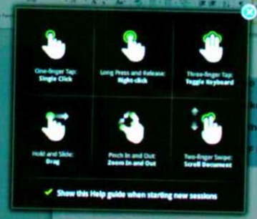
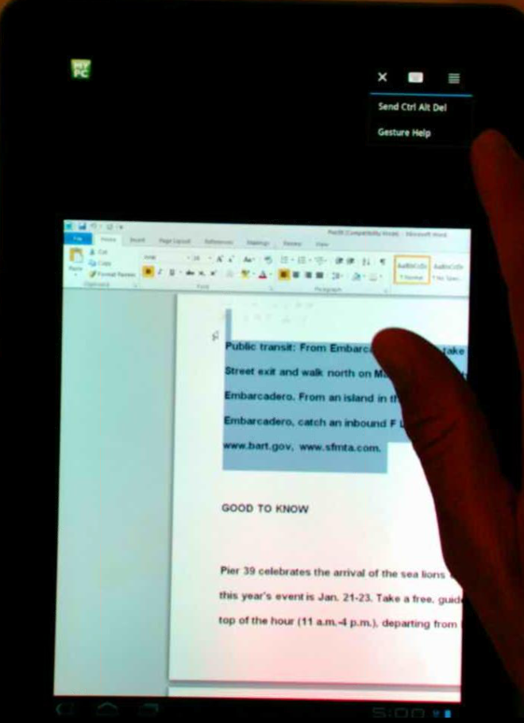
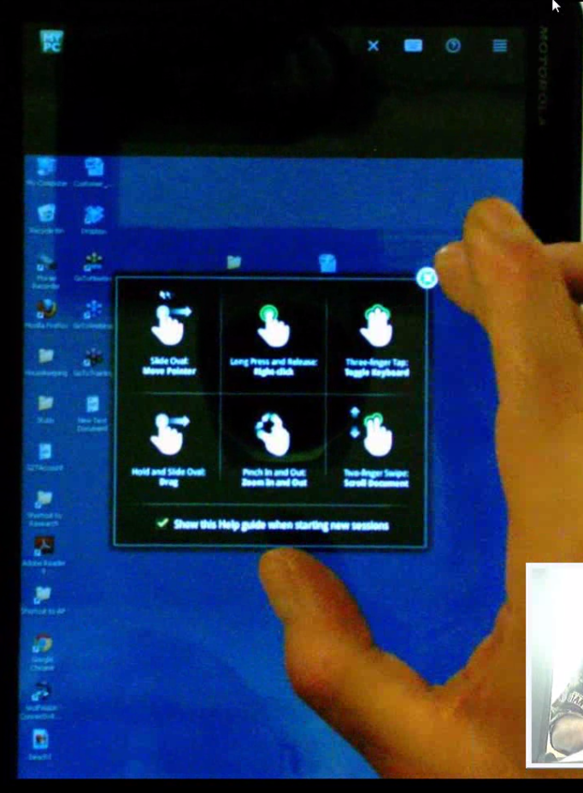
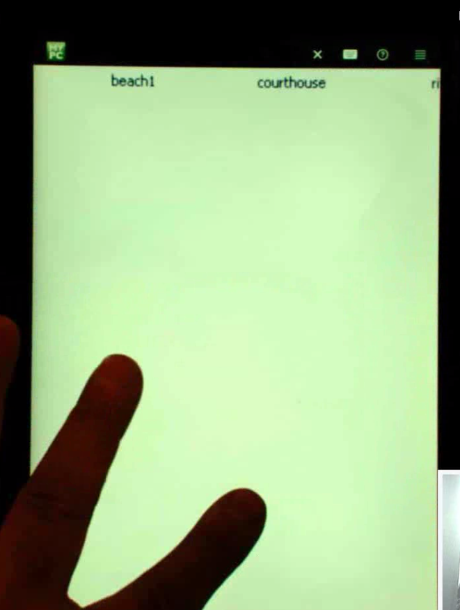
Gestures
Day 1
Most users liked the gesture help when they initially logged in.
Most users mentioned they would like to either not have it show up every time or have it show up only the next few times, but only one user noticed the check box on the bottom.
Most of the users at some point during the test mentioned that it would be helpful to see the gestures help again, but only one user actually found it on their own.
Day 2
Notes:
“I did not commit those six moves to memory, so I was not really sure
Rethinkg the screenshots here
“I did not commit those six moves to memory, so I am not really sure.”
“If I had those little directions from before, that would probably help.”
-Joshua

Slide 7
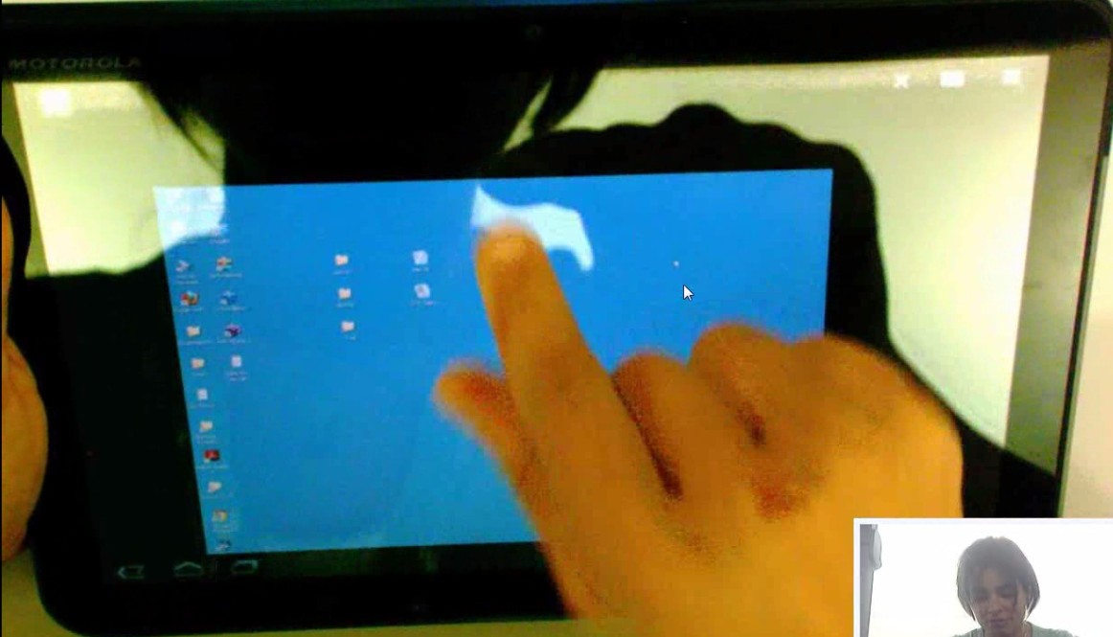
“Scale To Fit”
Some users mentioned that they would like the option to fit the entire screen on the Android device display.
Some users thought scale to fit was an option, they were just not sure where to find it.
“ What I would like is for it to auto size or auto fit my screen. I think there is an option here, but I just do not know where it is.”
- Peter
“I do not know how to scale to fit. I am trying to position perfectly. It would be nice if it could fit.”
- Gelareh

Slide 8
Task 2: Accessing Files, Pan and Scan, Drag and Drop

Slide 9
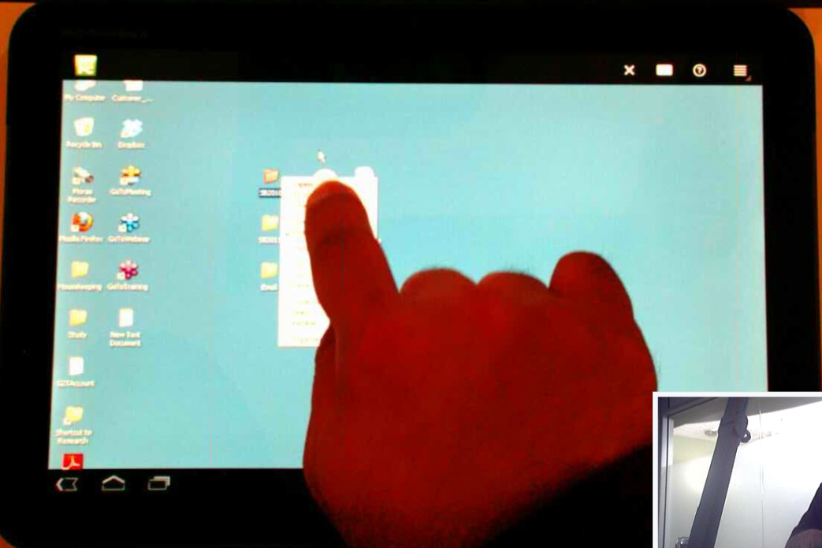
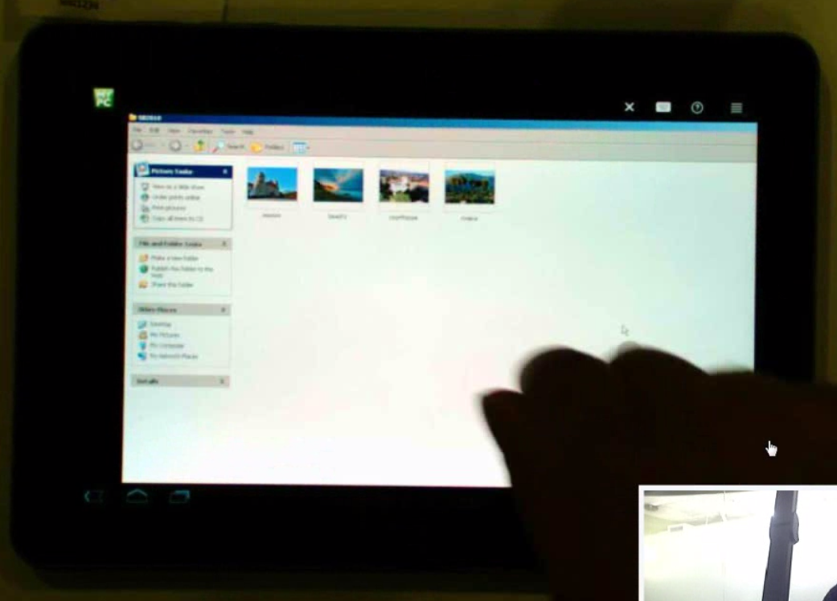
Accessing the Folder
Some users had trouble double-clicking when they were trying to access a folder on the desktop.
Some users maximized the window when they opened the folder and were not able to minimize it in order to drag and drop.
“I guess maybe I didn’t listen to the rule. I was double-clicking, is that right?”
- Harold
“You want me to drag, but I can’t get to the desktop”
- Julian
Notes:
Users would want to drag and drop, but it was in full screen and could not minimize

Slide 10
Drag: Folders and Windows
Most users had trouble when attempting to drag and drop the photos.
Some users missed the folder.
Some users thought it took a little while and required more effort than they expected.
Some users wanted to multi-select the photos.
When some users could not figure out how to drag and drop, they would try to move the photos in another way:
Copy/Paste
Move into another folder (Windows Explorer option)

Slide 11
Task 3: Typing/Attaching Files

Slide 12
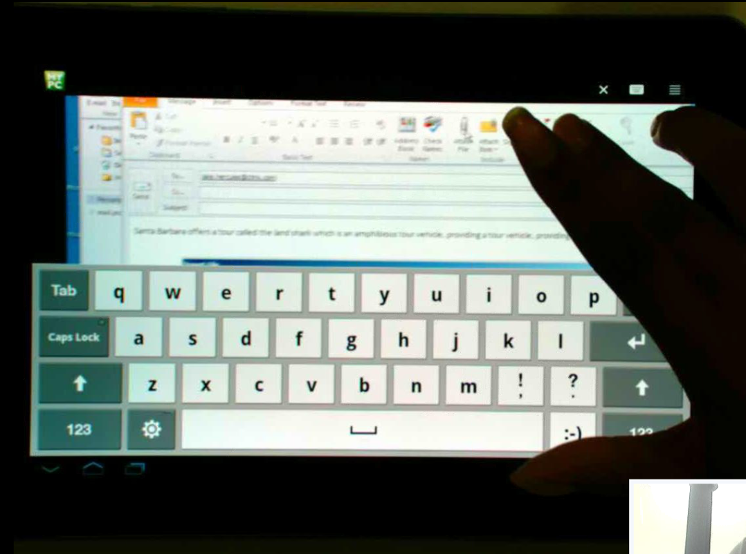
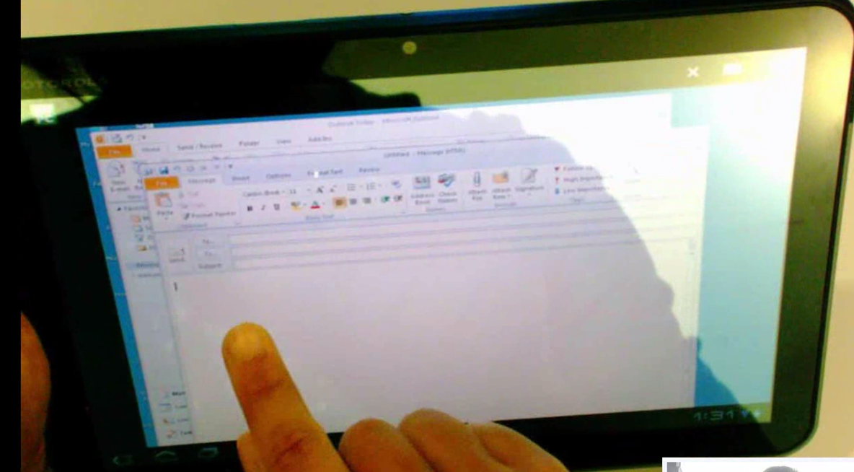
Keyboard
Most users were expecting the keyboard to pop up when they tapped on the text field.
Most users struggled to find the keyboard icon in order to bring up and dismiss the keyboard.

Slide 13
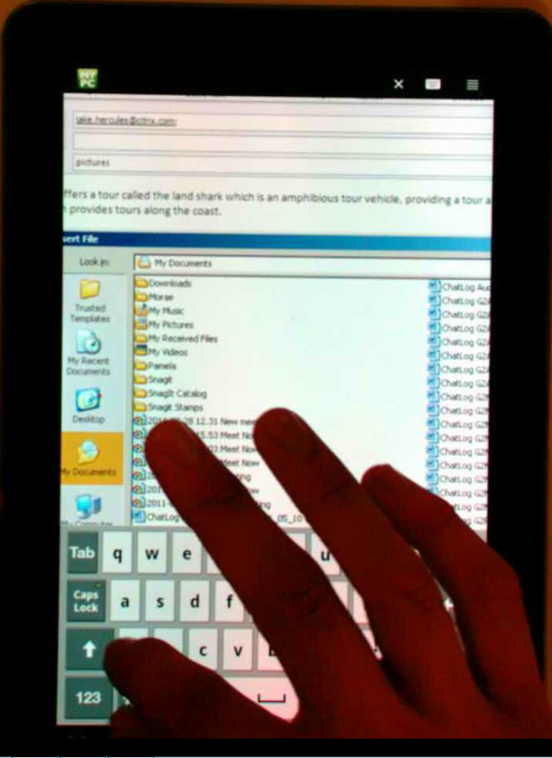
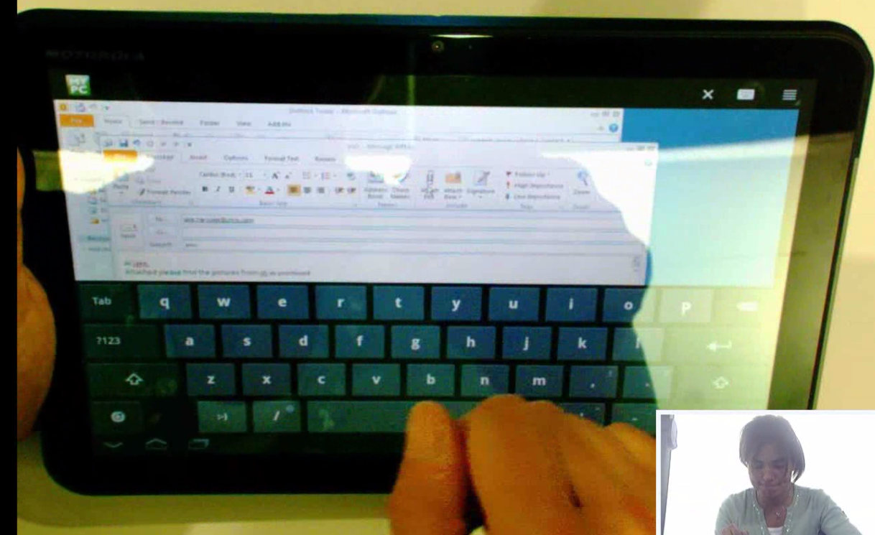
Attaching Photos
Some users clicked Attach File a few times before realizing that the Attach File window was open, but hidden behind the keyboard.

Slide 14
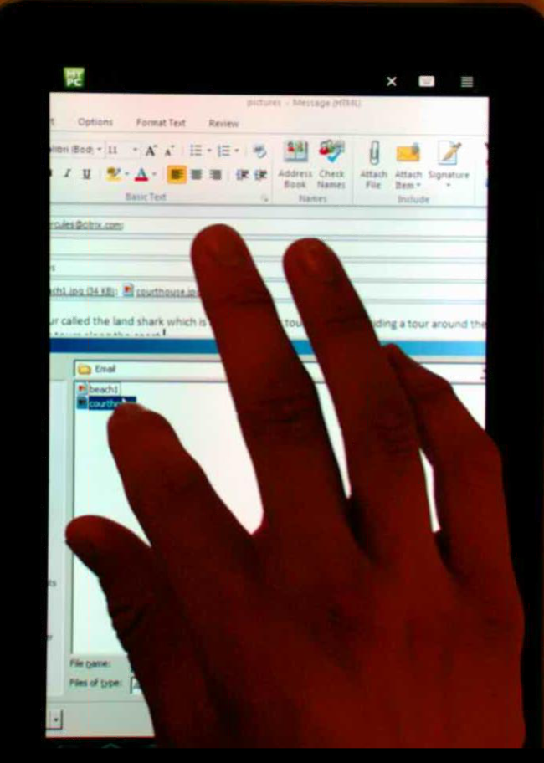
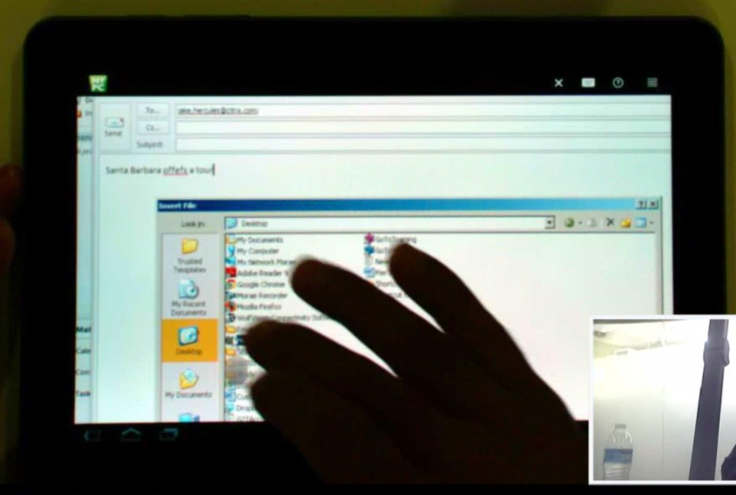
Attaching Photos
Most users had trouble when they were trying to open the email folder and would select the wrong item.
Most users preferred to select both documents simultaneously when they attached them to the email, but ended up attaching them one-by-one.
“Oops, I do not want to rename it, I just want to SELECT it.”
-Harold
“I thought I hit email, but hit housekeeping. I have clicked it now two times.”
-Julien
Notes:
“I am trying to figure out, how to I minimize this”

Slide 15
Typing
Some users expected the predictive text functionality to work while typing their email on the host computer.
Some users thought that typing on the Android device was difficult and said they would wait to do typing work until at a laptop or desktop.

Slide 16
Task 4: Multi-Tasking

Slide 17
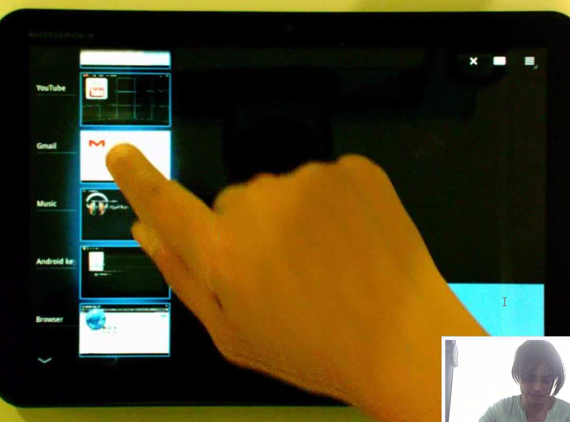
Multi Tasking with Notification
Some users did not notice the email notification when the email first came through. Some users did notice the Gmail icon in the notifications bar.
Most users, when asked to check their email, went to the multi-tasking button to do so.
Some users were looking for a way to minimize GoToMyPC in order to make sure it was still running.
<Screenshots>

Slide 18
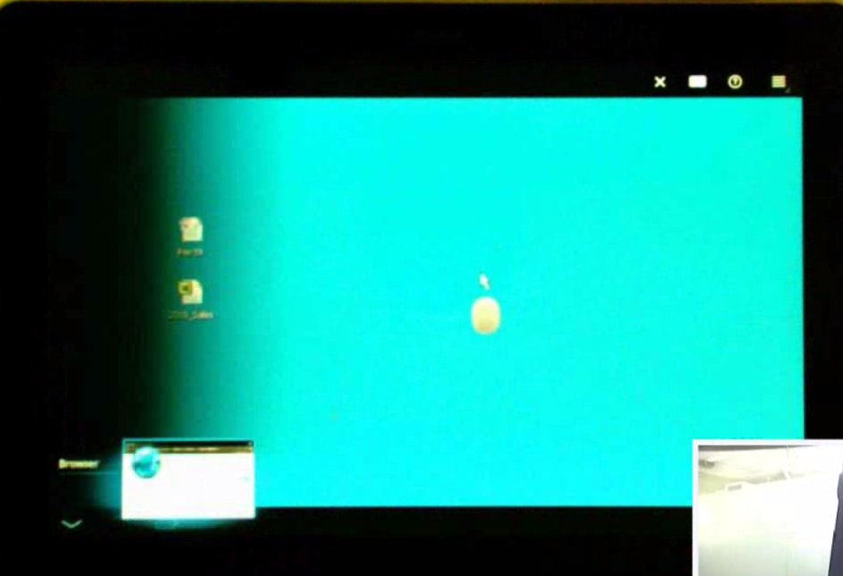
Multi-Tasking without Notification
Sreenshots
Most of the users that were asked to multi-task without a notification used the home button to do so.
When some of the users would multi-task they were not confident that their session was still running.
Some users were still looking for a way to minimize GoToMyPC in order to make sure it was still running.
“I am trying to figure out, how to I minimize this”
-Julian
Notes:
Whetehr it was pressing home ot multi-tasking they were ntot confident that the G2P was still running the the background
The muti- tasking with the notification is all about multi-tasking on the eivce, which is not really our concern. The fact that they are having trouble multi-tasking

Slide 19
Task 5: Scrolling/Copy/Paste

Slide 20
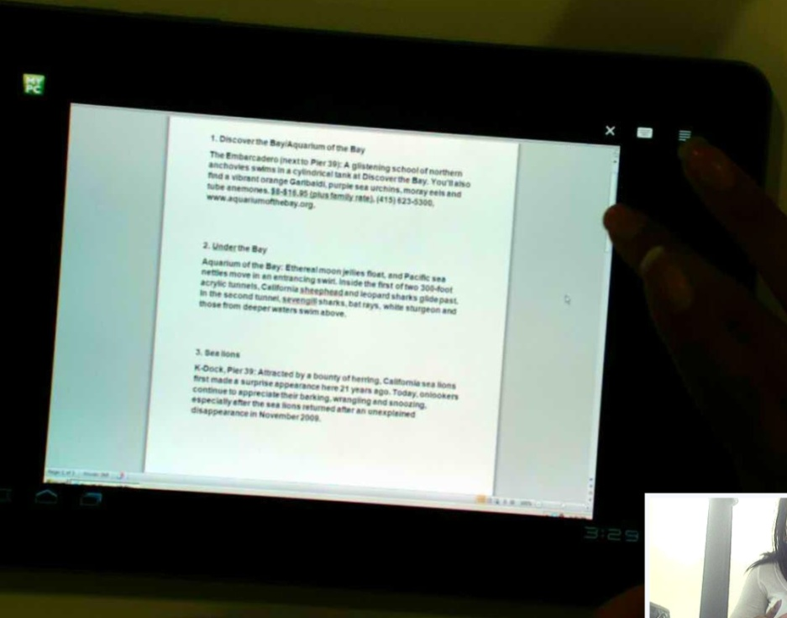
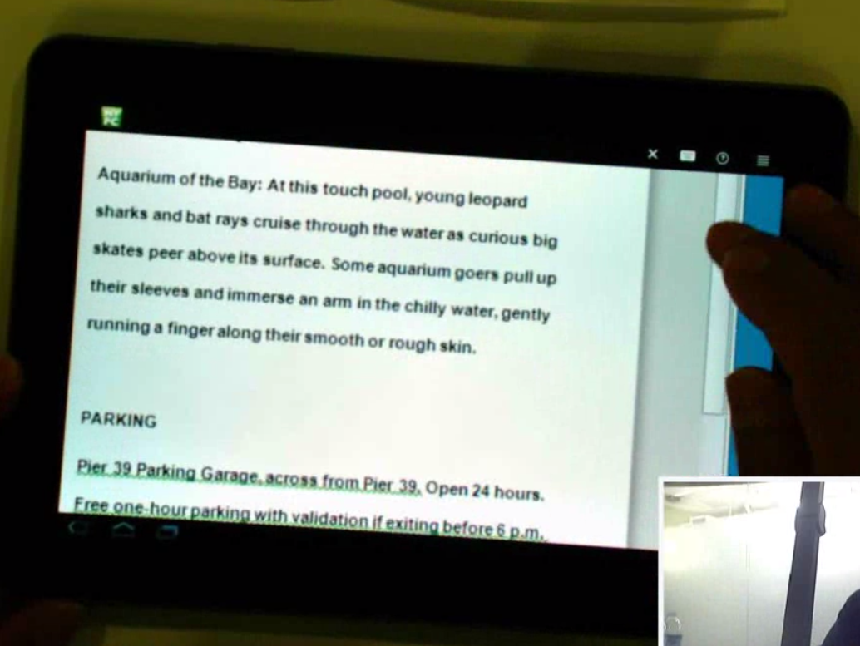
Scrolling Gesture Change
ISSUES:
All users used the scroll bar in Microsoft Word to scroll down and did not use the gestures to assist them.
Influence:
No significant influence, users behavior did not significantly change.
Change: Moved the gestures menu
Notes:
Users were

Slide 21
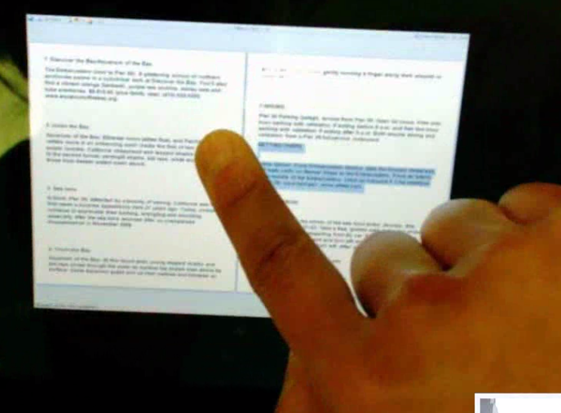
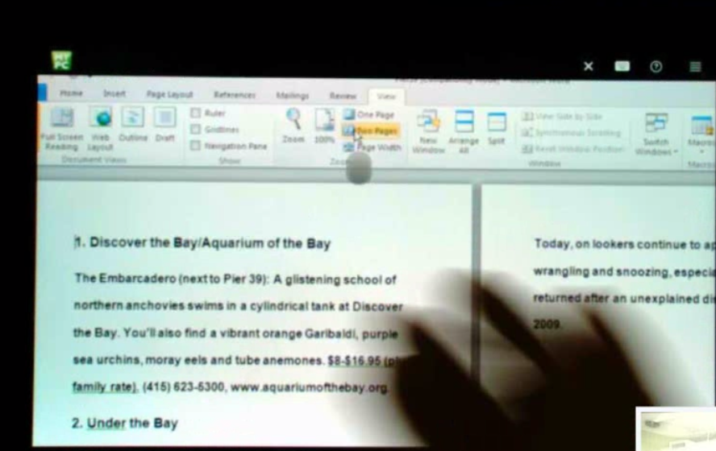
Scrolling Key Takeaways
Some users changed the view of the Word Document to find the directions because they were unable to easily scroll.
Most users used one finger to scroll when they first started scrolling down the document, but noticed it was moving the whole screen instead.
“It is not really easy to scroll this. Let me change the view to the print preview”
-Gelareh
Notes:
I would think that If I hit the scroll

Slide 22
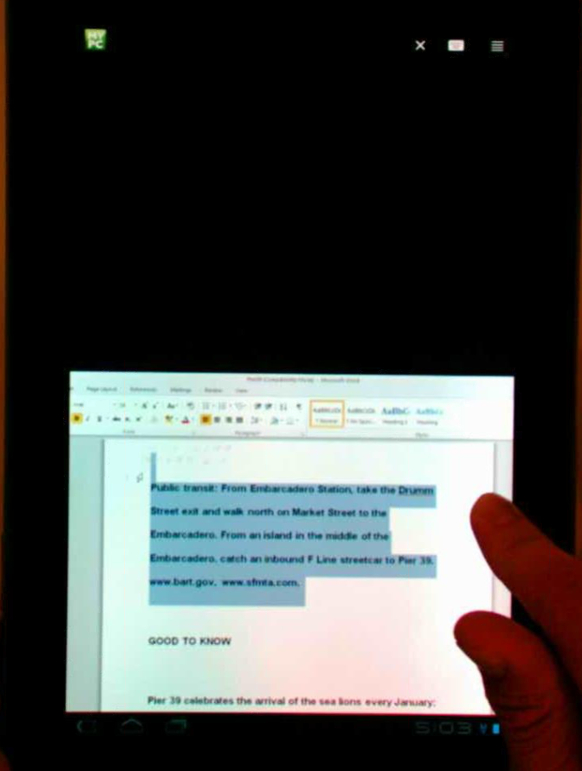
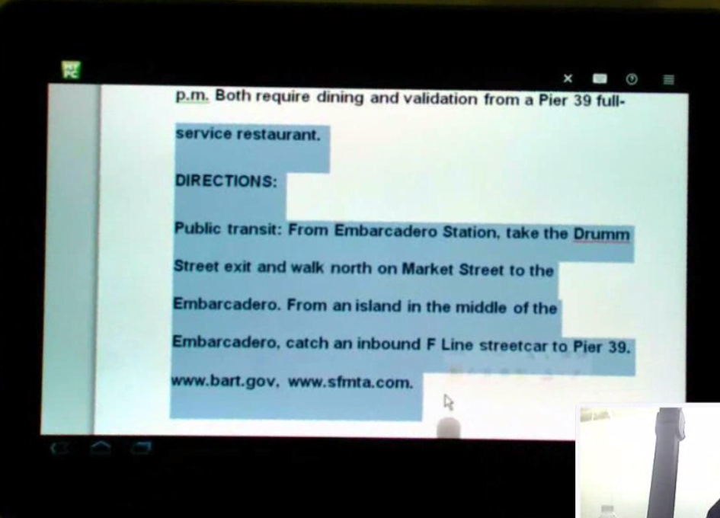
Highlighting
Most users needed to attempt to highlight more than once in order to highlight the correct area.
When some users were trying to right-click to copy, they would click or double-click on or around the highlighted area, which would remove the highlight from the desired text.
Notes:
Most users were blaming

Slide 23
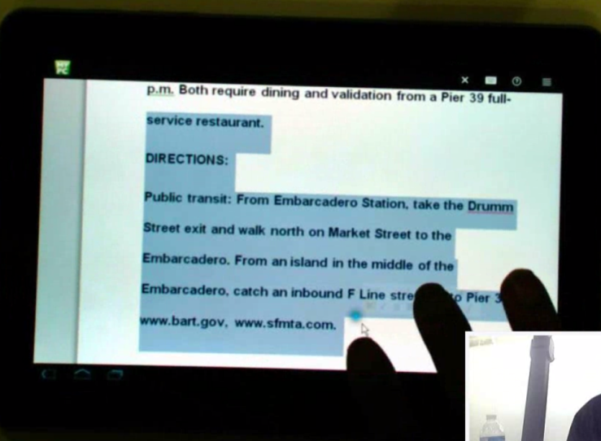
Copy and Paste Gesture Change
ISSUES:
All users had trouble copying.
All users ended up using the copy icon or file/edit in Microsoft Word to complete the task, but wanted to use Ctrl-C or right-click.
Of the users who struggled, none of them completed the task as they had intended to.
INFLUENCE:
Some users gave up on the copy and paste until they were given help by the facilitator.
GESTURE CHANGE: Since users were struggling with the right-click gesture on the first day, we added more time to the long press and the option to hold down the oval in order to initiate right-click.
Notes:
Put it an image of someone pressing on the oval and it lighting up

Slide 24
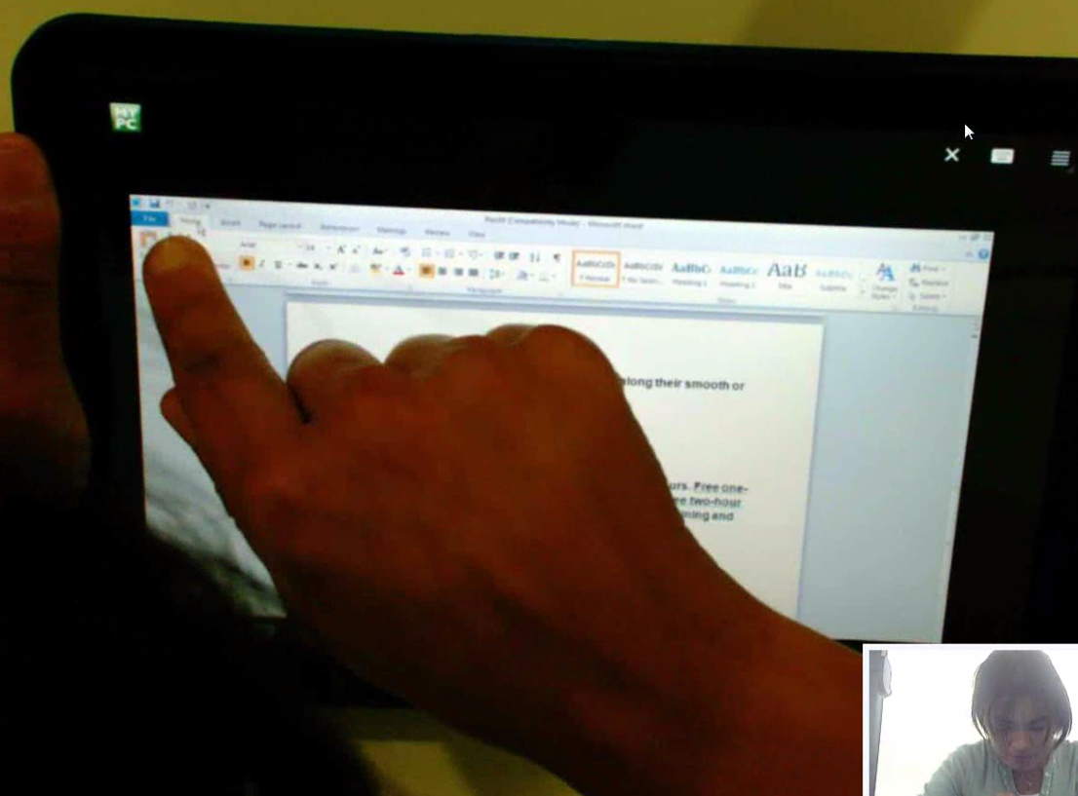
Copy and Paste Key Takeaways
Some users tried to use Ctrl-C, but the shortcut was not available.
Some users tried and preferred to use right-click, but did not know how to do it successfully.
After most users discovered how they would copy, they would use the same method to paste.
“If I do not use the hot key, like Ctrl-C, then I would normally do right click.”
-Peter
“I use this version of Microsoft Word, I am just now used to copying it this way.”
-Nicole

Slide 25
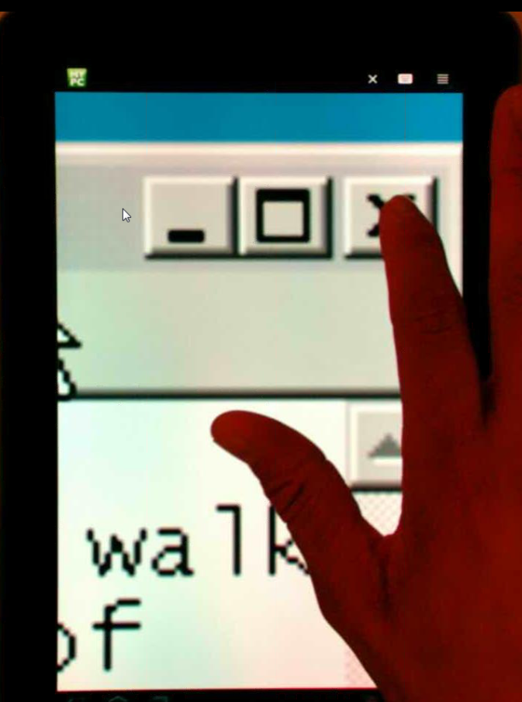
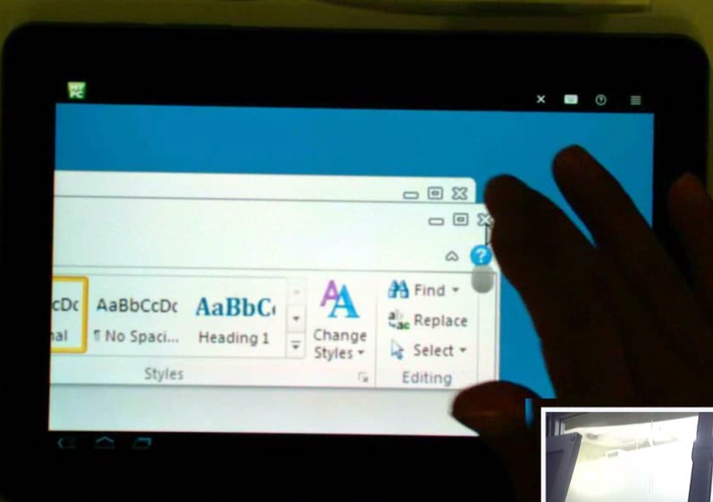
Closing the Document
“I can’t even close this thing at this point. I know I have hit it several times.”
-Julian
When most users closed out of the document, they clicked the "x" a few times before noticing that the dialgue had popped up, since they were too zoomed in to see it.
Some users mentioned that it would be nice to have the dialogue appear in the center of the screen they were looking at.

Slide 26
Task 6: Disconnect

Slide 27
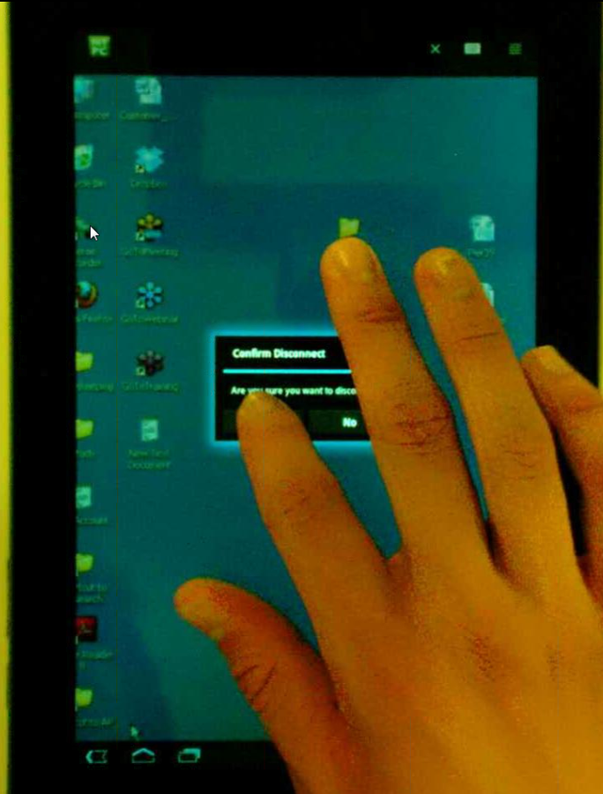
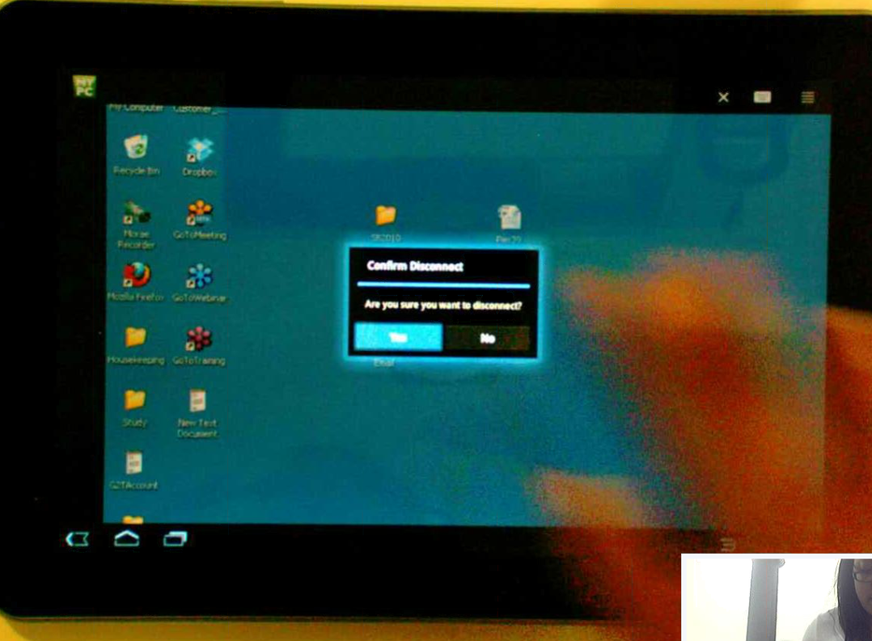
Disconnecting
Most users used the X to end their GoToMyPC sessions.
Some users mentioned that the reason they knew they could end it this way was because they had accidentally hit it during other tasks.
Some users ended their session by using the back button.

Slide 28
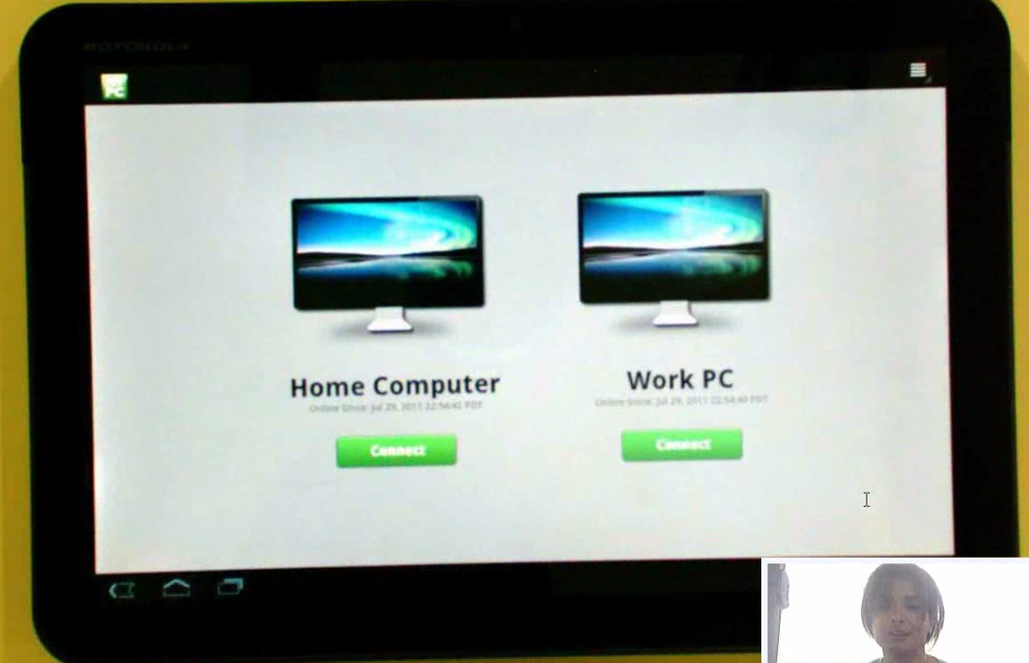
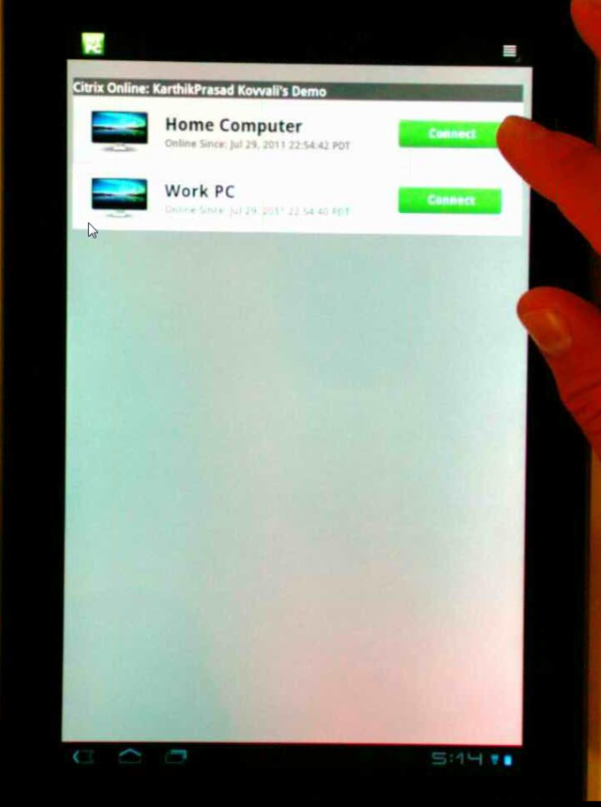
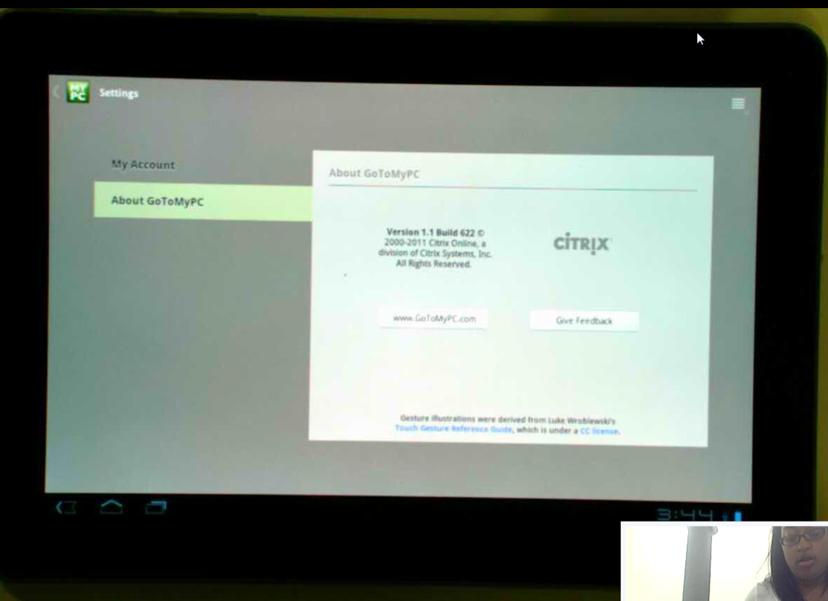
My Computers Page
Most users, when asked to reorganize their my computers page, went to Settings in order to do so.
Once users found “List View,” most users preferred “Icon View.”
Notes:
Put a screenshot of list view

Slide 29
Gestures

Slide 30
Gesture Scheme A
All users had problems with the long press when attempting to right-click. It was not working as they expected.
Most users understood that their finger was used in place of the their mouse on a regular computer. Some participants mentioned that they prefer it that way when using a tablet.

Slide 31
Gestures Scheme C
Some participants would use their finger instead of the “mouse” unless they felt it could assist them in completing the task.
When some users began using the oval to complete their task, they became frustrated with it or were confused by its intention.
Users were calling the oval a variety of different things:
Fingerprint
Doo-da
Thingy
Push button
Cursor
“I am trying to figure how to get it to work with this little doo-da. I can’t push it over to where I want it.” -Harold
“I see the cursor…That little flash thing, I am doing it now, but I am not sure how I did it.” -Peter
Notes:
Fingerprint. Is it telling me that is where I am going to tap. Ahhhh…ok, if I press hard, I can preview. It is like a pointer to poing my finger a little better. I did not know realize I was doing. Idid not realize what I was tapping and what I Was not tapping. I was trying to get thing opened, but I am opening and closing it at the same time. I think I just pressed on the thumbanils and it closed it.

Slide 32
Wins
Most users did not have any issues with logging in to the app, connecting to the host from the My Computers screen, and entering in their access code.
All users did not have any trouble disconnecting from GoToMyPC.
At the end of the session people were asking when this app was going to be available because they were excited about it.

Slide 33
Overall Key Takeaways
Overall, most participants were frustrated when:
Attempting to scroll.
Attempting to right-click.
Figuring out how to highlight items on the screen.
The keyboard did not automatically appear and disappear when they moved in and out of text fields.
They could not click what they had intended to click.
Notes:
33

Slide 34
Recommendations
Call the key board when in the text fields and dismiss when not.
Revisit gesture options for Right-Click, Highlight, and Scroll.
Default host screen to fit the Android display and give the user an obvious way to reset it.

Slide 35
Next Steps
UXR, Laura, and Gaurav are planning a usability day to test various gesture schemes.

